Slide 1



Adaptation
Design a Species
www.britishscienceassociation.org/creststar
Notes:
For more information about the CREST Star Investigators programme visit - www.britishscienceassociation.org/creststar

Slide 2
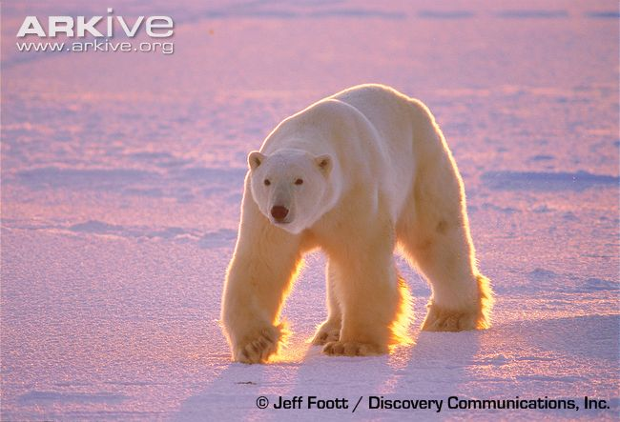
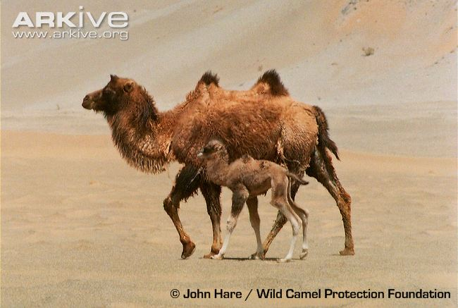
What is adaptation?
The way animals and plants become better at living in their habitat.
Adaptations allow species to live successfully in their habitat.
Species living in different habitats need different adaptations.
Notes:
Explain the concept of adaptation
Adaptations allow animals and plants to live successfully in their habitat e.g. help get the food they need, to communicate with each other, and to avoid predators
Because habitats are different, animals living in different habitats need different adaptations – compare the polar bear and the camel

Slide 3
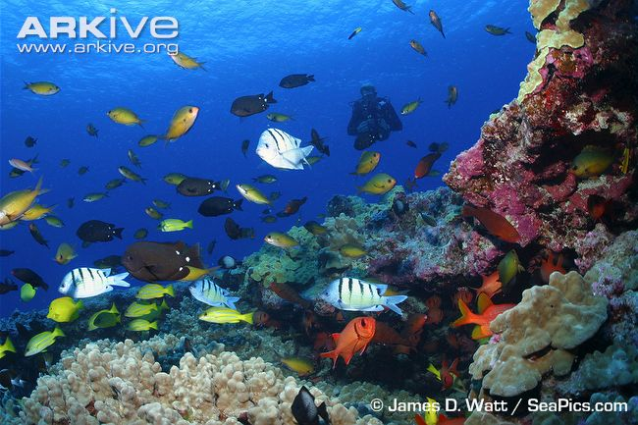
Marine habitat
Notes:
Species are adapted in different ways to be successful in different habitats
Case study: the marine environment. The marine habitat is everything that lives in the sea
This habitat presents a number of challenges for the species that live there.
How are animals and plants adapted to survive in the marine environment?

Slide 4
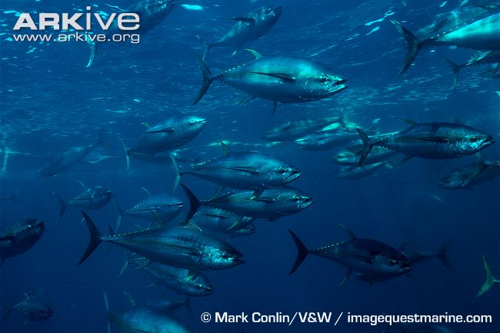
Movement
Yellowfin tuna
Notes:
The water itself is the biggest challenge for most species that live in the marine environment.
It is harder to move through water than through the air because water is more dense.
Species that need to move through the water quickly need to be streamlined, have strong muscles and fins to cut through the water and move quickly.
The yellowfin tuna (above) is a good example of this.

Slide 5
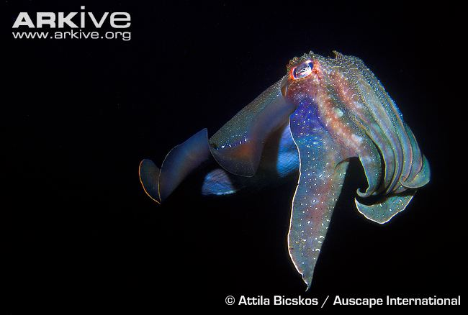
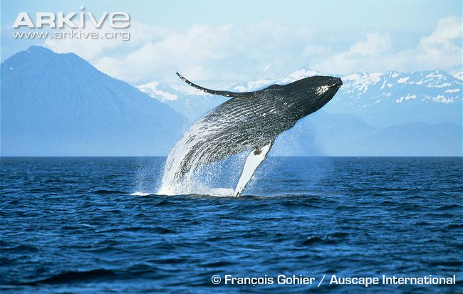
Communication
Giant cuttlefish
Humpback whale
Notes:
Communication or the way animals talk to each other, is also a challenge underwater.
Some species use visual communication, for example the giant cuttlefish changes colour, like a chameleon, to communicate with other cuttlefish. This only works at short distances in good water visibility.
Larger species that need to communicate over long distances use sound, as this travels better underwater. For example the humpback whale sings underwater to communicate with each other.

Slide 6
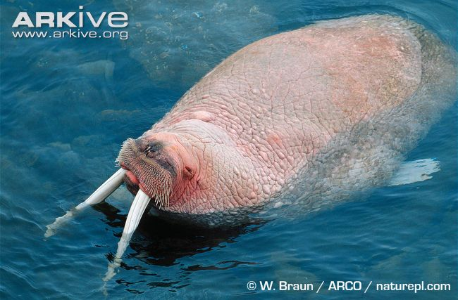
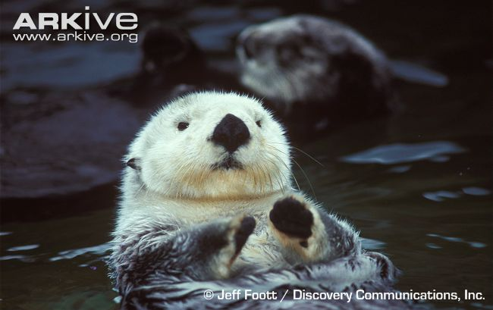
Regulating body temperature
Walrus
Sea otter
Notes:
The sea is very cold, so some animals have adaptations to keep them warm
This is because the water is generally cold and species will lose heat to a cold water environment.
Marine mammals like the walrus (Odobenus rosmarus) tend to use fur and/or blubber, as insulation. Blubber insulates better than fur when diving deep and blood flow can be regulated through it to get rid of excess heat if required (hence the pink colour of the walrus at the surface).
Some species also use behavioural adaptations to regulate their temperature, e.g. the Galapagos marine iguana (Amblyrhynchus cristatus) is cold blooded, therefore relies on basking in the sun to generate enough heat to enable it to swim in the cold ocean and feed on algae. The Galapagos marine iguana basks on hot rocks in between feeding bouts.
The walrus has a thick layer of fat for when it dives deep to search for food.
The sea otter uses fur to keep warm – it has fur that traps air between its body and the water, like a diver’s wetsuit!

Slide 7
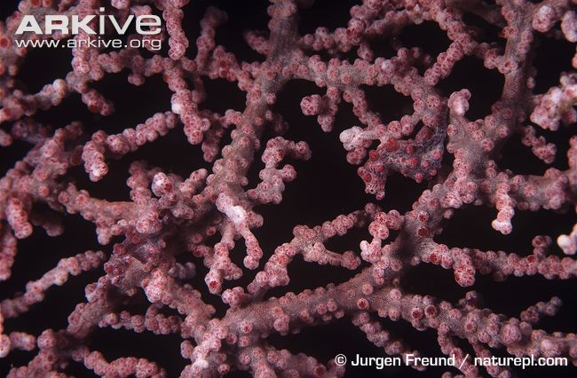
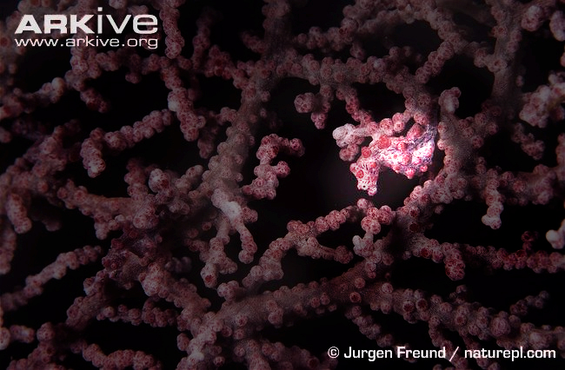
Camouflage
Pygmy seahorse
Notes:
Camouflage is also used by species living in the marine environment.
It helps species avoid detection by other species.
Camouflage can be used to avoid predation or can be used by predators to sneak up on prey.
There is also camouflage – does anyone know what this means?
It is the way animals hide from other animals, usually predators, by changing the way the look such as by changing colour.
The pygmy seahorse is a great example of this, camouflaged amongst a fan coral – can you spot it?
Click mouse to reveal the seahorse.
The pygmy seahorse uses camouflage to blend in with the coral that it lives on. This stops it getting caught be predators.

Slide 8
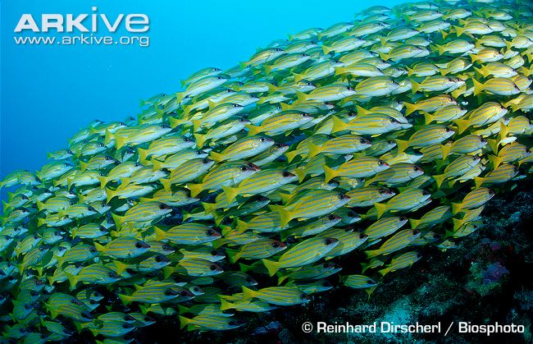
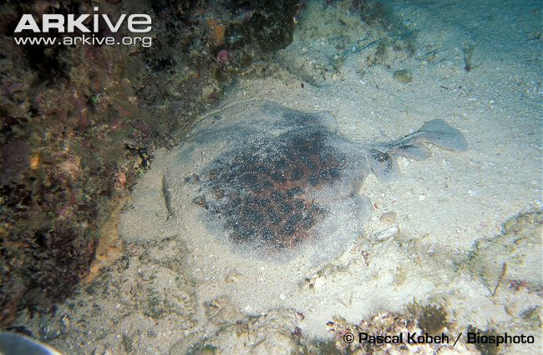
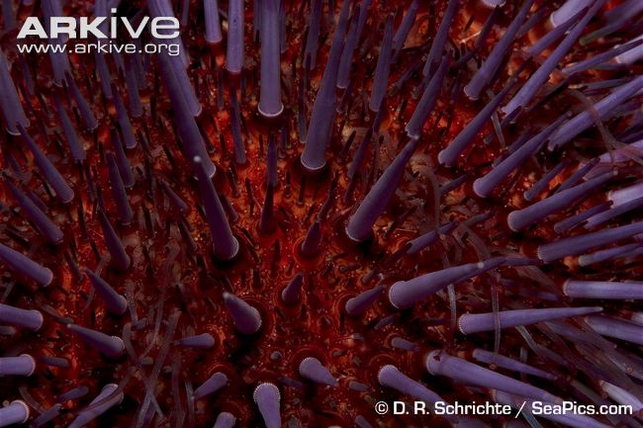
Escaping predators
Five-lined snapper
Gulf torpedo ray
Purple sea urchin
Notes:
Many animals have adaptations for the same reason – to escape from predators. Noone wants to be eaten!
In the sea, fish such as five-lined snapper form huge groups called schools. In a group, there is safety in numbers. This is why many land animals such as zebras form herds.
You could also have physical defences – for example sea urchins have hard spines that stop predators from eating them.
Another example of this is the torpedo ray – this ray protects itself using an electric shock, and also hides by burying in the sand.

Slide 9
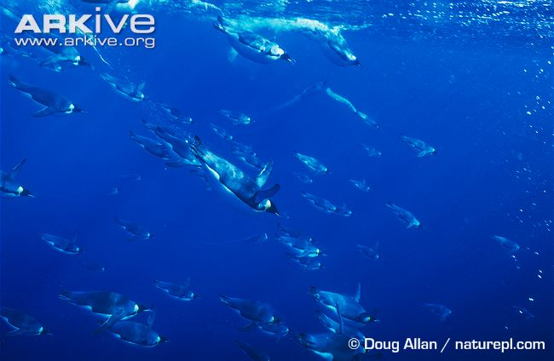
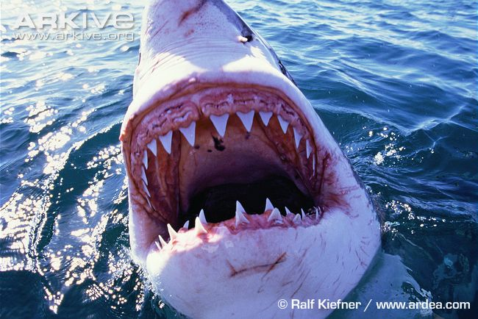
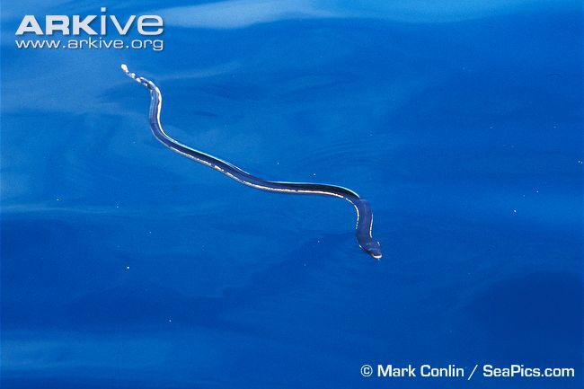
Effective hunting
Emperor penguin
Great white shark
Yellow-bellied sea snake
Notes:
If you are a predator, then you need adaptations that make it easier for you to catch your prey
For example, you could hunt in a group and work together, like emperor penguins do.
You could use poison to subdue your prey, like the sea snake.
Or you could be like the most effective sea predator of all, the shark, and have huge teeth!

Slide 10
Design your own species!
Divide into small groups
Each group will be given a habitat card and either predator or prey card
Think about the species that live in your habitat and what adaptations they have to help them survive. For example polar bears have large paws with retractable claws to help them dig into snow in their icy habitats.
Now design your own species for the habitat you have been given!

Slide 11
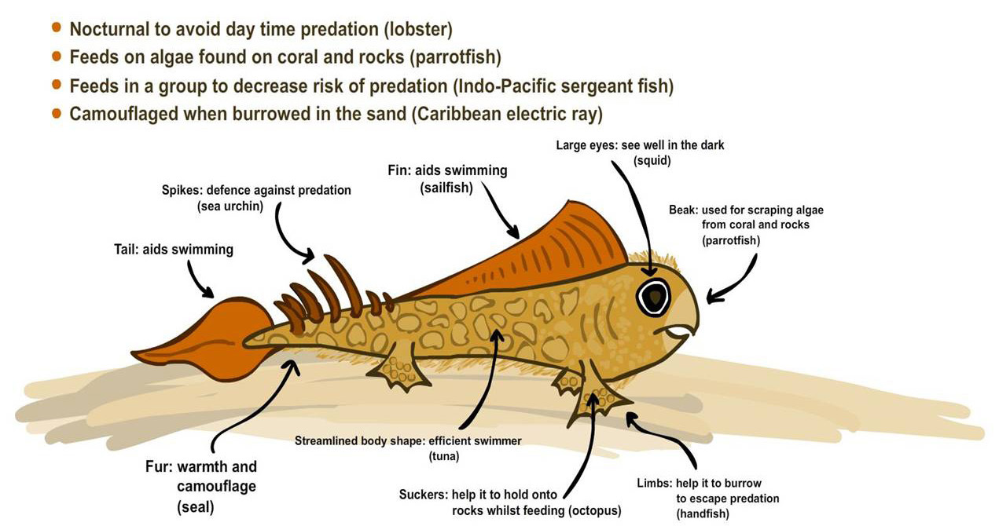
Meet the spiny skipper – a prey species adapted for the marine environment.
Notes:
This is an example of a prey species adapted to the marine environment, designed by the ARKive team.
The adaptations from different marine species are included in the labels.

Slide 12
Things to think about…
What does it eat?
Is it brightly coloured or camouflaged?
How does it move?
Does it live with other members of the same species?
How does it keep warm / cool?
Where does it live? E.g. trees? Burrows? Underground?
How big is it?
Notes:
- These are some suggested themes for adaptations that it might be useful for the students to think about when designing their own species.

Slide 13
This activity is accredited by the British Science Association and can count towards the CREST  Investigators SuperStar Award
www.britishscienceassociation.org/creststar

